Slide 1
Water Level Sensors
in Environmental Science

Slide 2
Understanding Rainfall vs Water Level Correlation (Hydrology) with a Water Level Sensor
High School Level

Slide 3
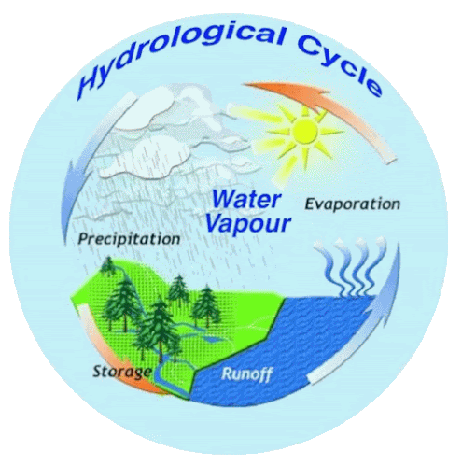
What is Hydrology?
Hydrology is the study of water on Earth. Hydrologist studies the way water is distributed, the quality, and the way it moves on and below Earth's surface, as well as in the atmosphere. They study how the water moves through bodies of water and into different types of reservoirs. For example, watersheds and aquifers. Hydrologist also studies the impact humans have on these processes.

Slide 4
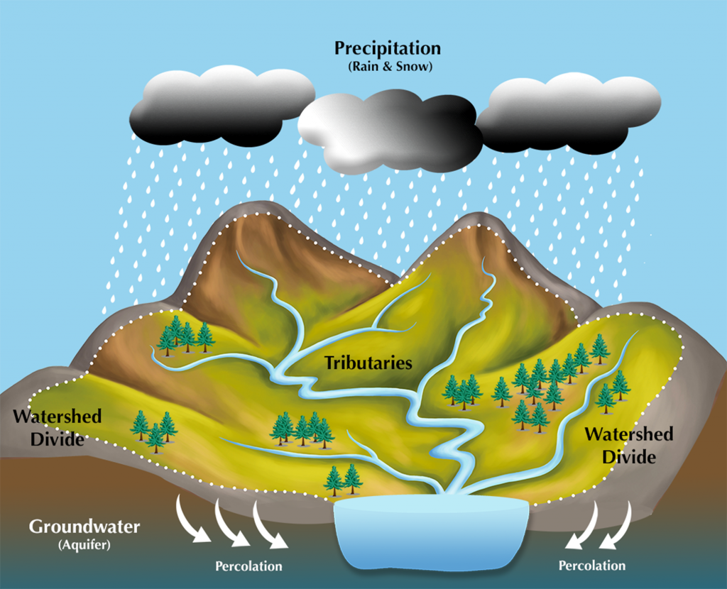
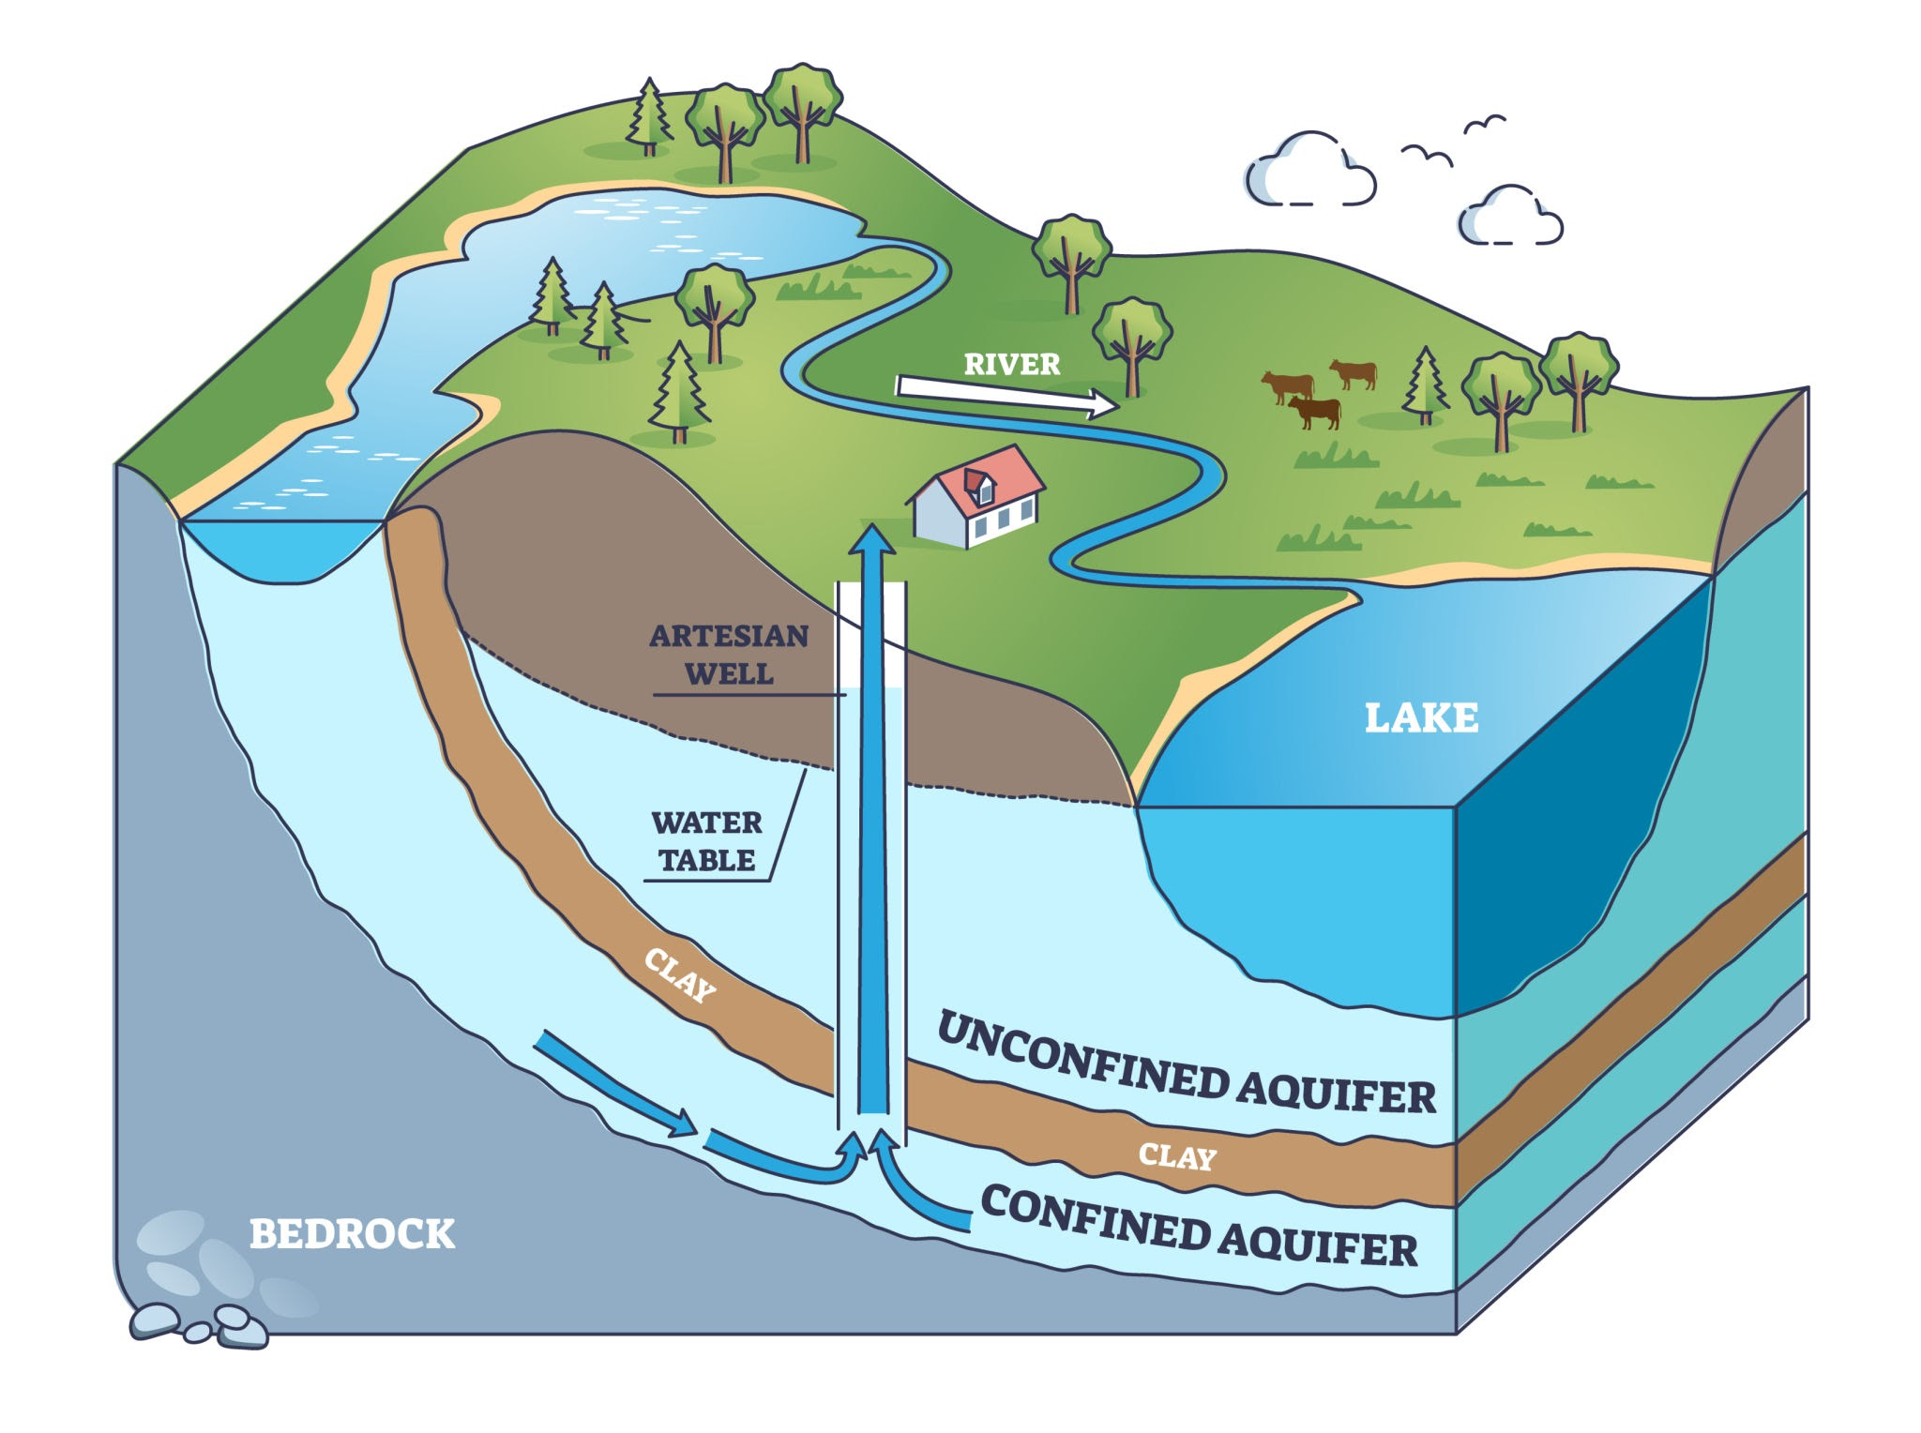
What are Watersheds and Aquifers?
Watersheds are an area where all forms of precipitation drain to. It is typically connected by a system of streams and channels to connect to one body of water. People rely on watersheds to provide clean drinking water.
An aquifer is a saturated body of rock or sediment that helps transport groundwater to wells and springs. Aquifers are also very important to humans because they provide clean drinking water as well.

Slide 5
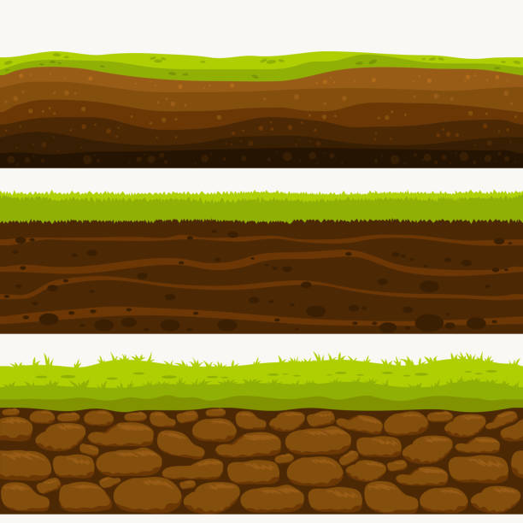
How Can We Measure Rainfall and Water Level in a Classroom?
Activity:
Students build a mini watershed model with soil, gravel, and a hidden container acting as an aquifer. The IO Rodeo water level sensor is placed in the “lake” or aquifer to measure how rainfall (simulated with watering cans) affects water storage. They compare how vegetation, slope, and rainfall intensity change runoff speed and aquifer recharge. By graphing rainfall amounts vs. water level changes, students learn how watersheds collect rain and how aquifers store and release water over time.

Slide 6
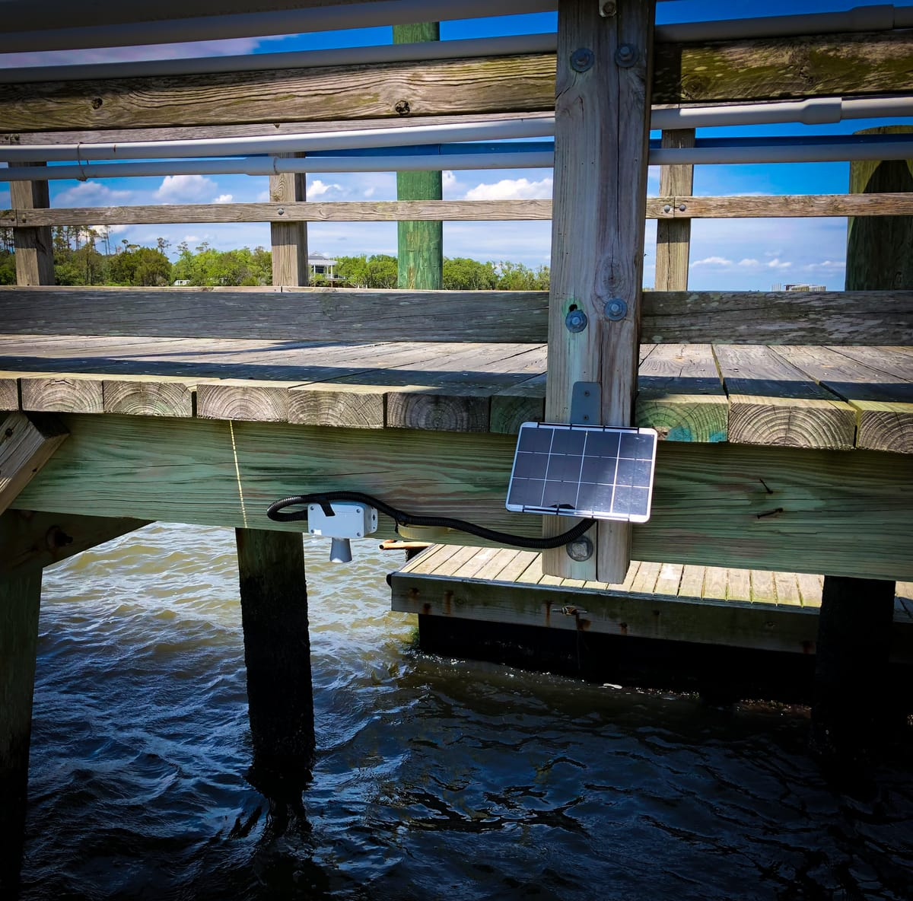
How the Sensor Helps
The IO Rodeo water level sensor helps students:
Measure how water levels change after rain
Compare rainfall amounts to water height in rivers or tanks
Analyze how surfaces (like pavement vs. grass) affect runoff
Collect data for graphs, scatterplots, and statistical analysis

Slide 7
Understanding Wetlands with a Water Level Sensor
High School Level

Slide 8
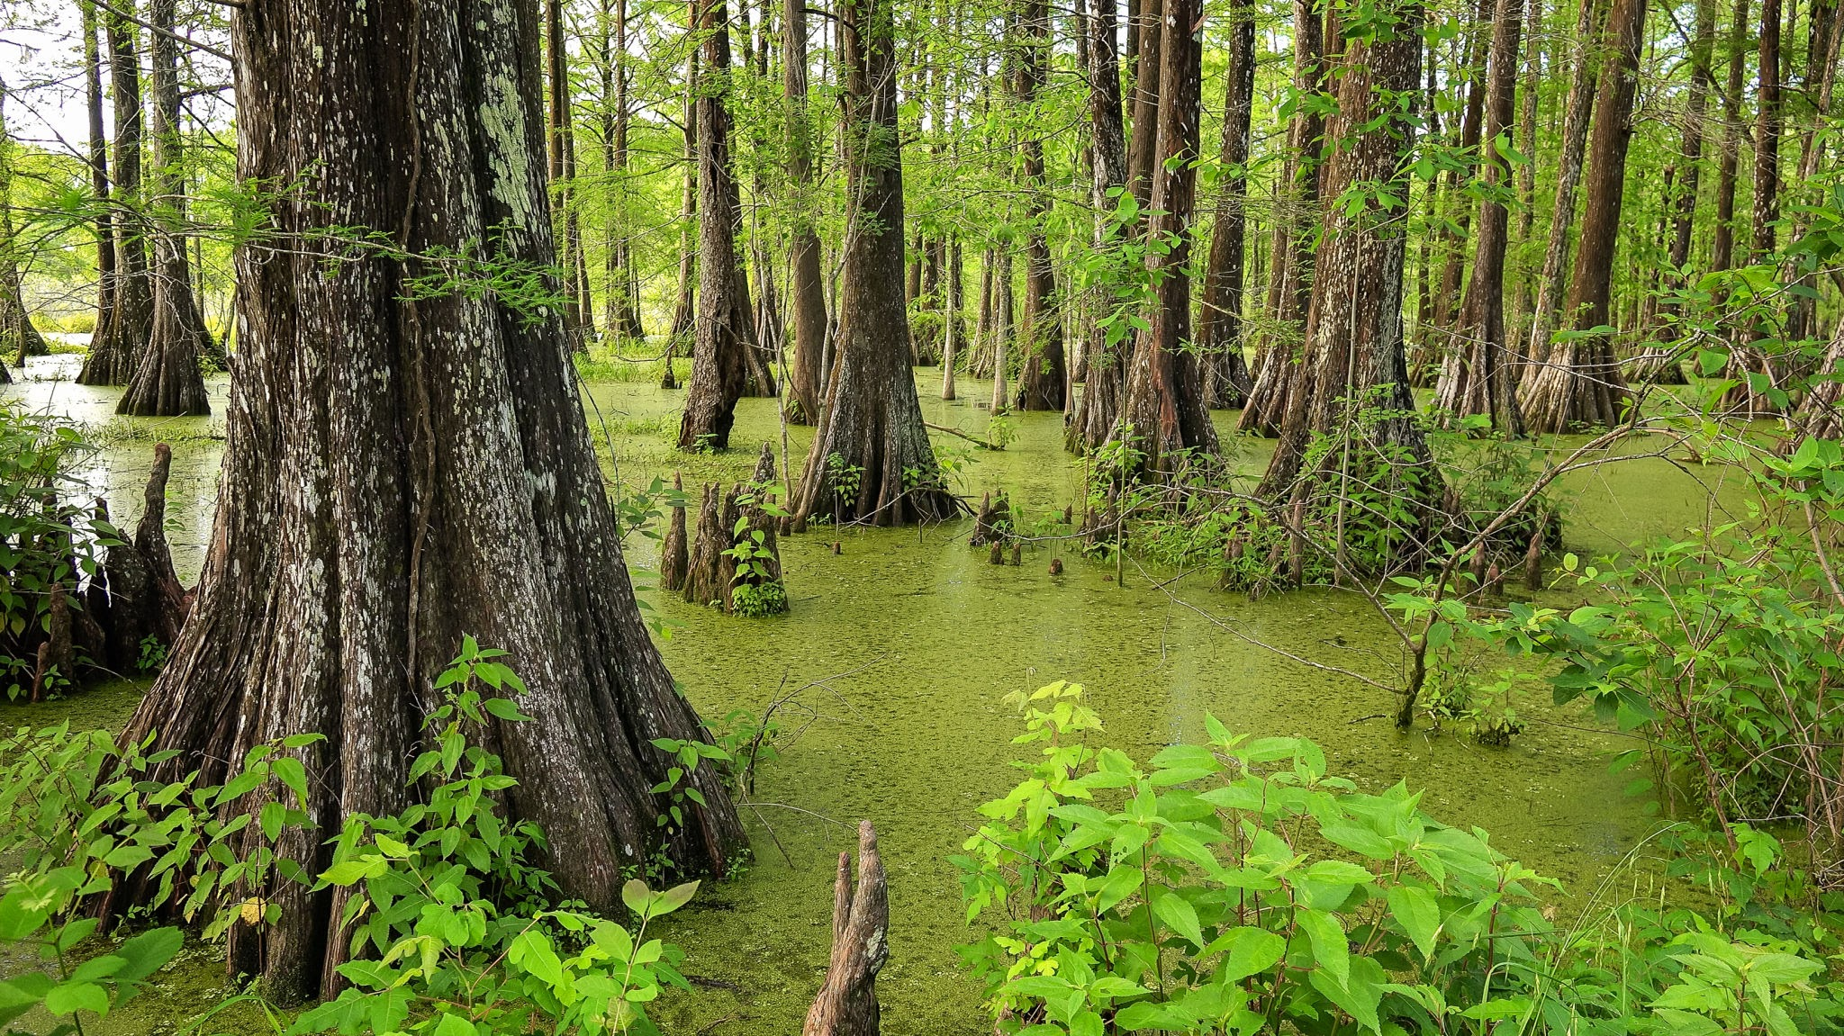
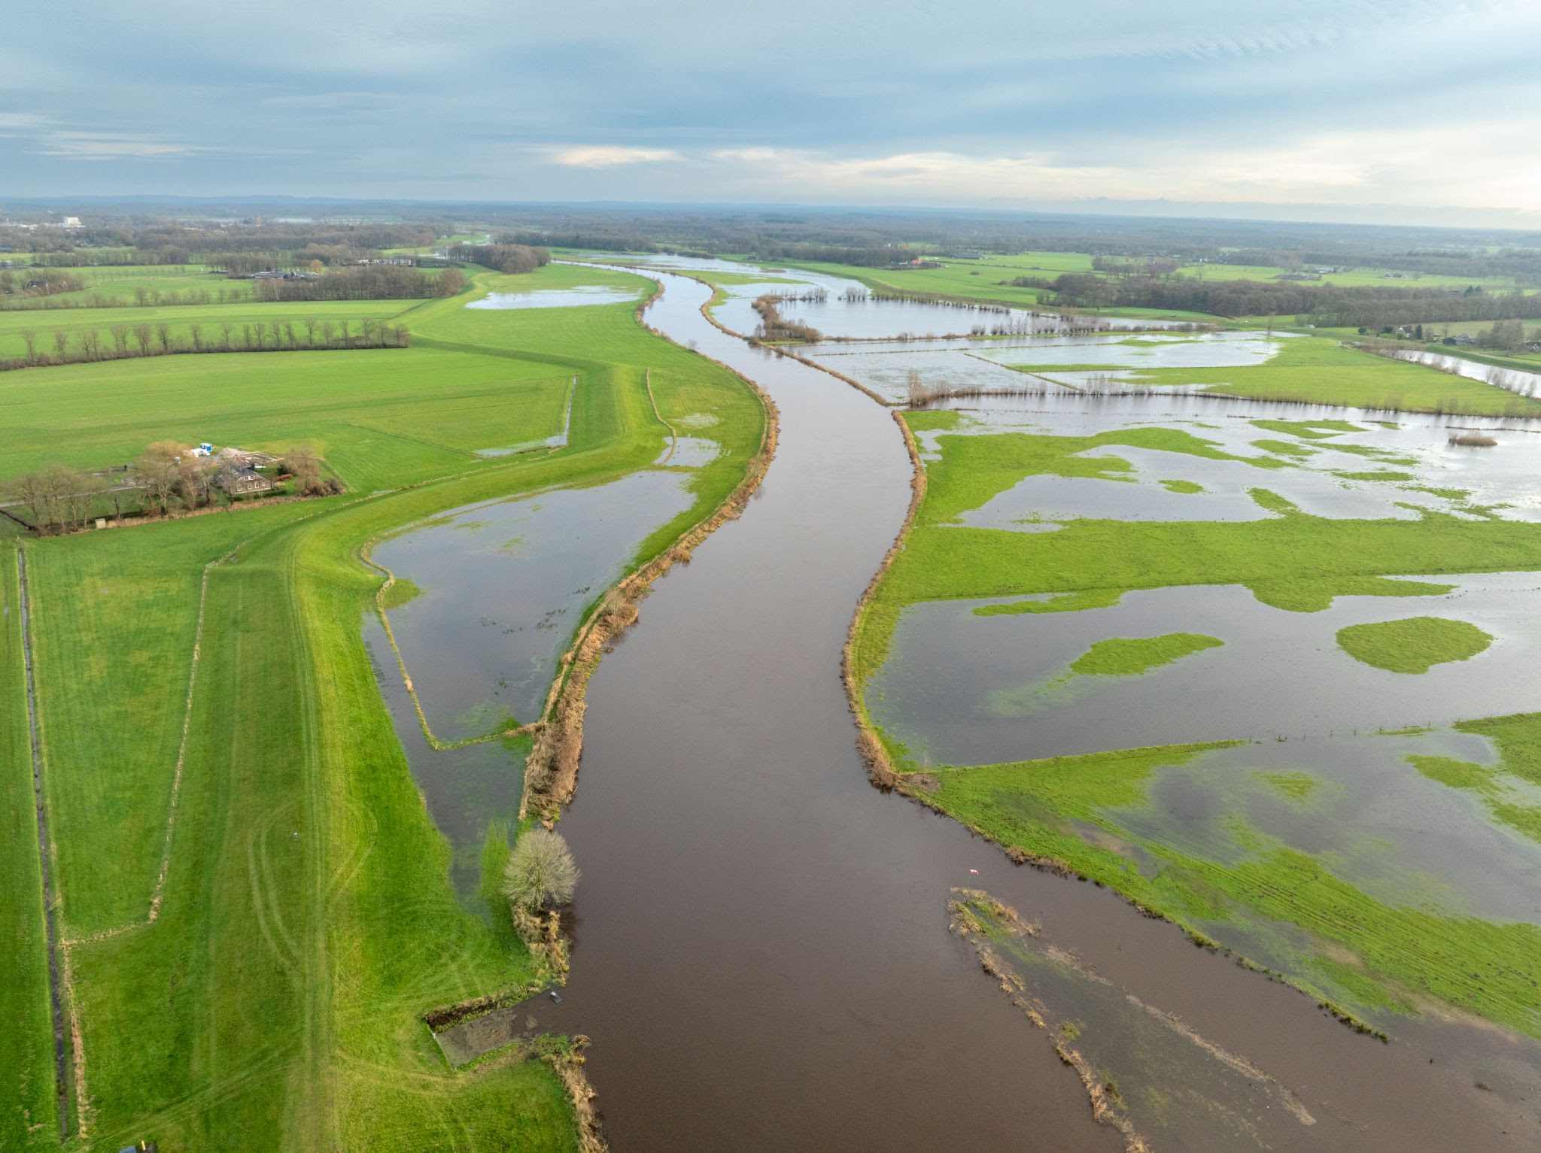
What are Wetlands?
Wetlands are areas of land that water covers. This can either be permanent or for a year. They are classified as being an in between point of fully aquatic and fully terrestrial. Some examples being, swamps, bogs, and floodplains.
Wetlands are crucial for decreasing the impact on communities from floods, providing habitats for unique plants and animals, and they act as a filter for water. They also help in climate protection by storing large amounts of carbon in plants and soil.

Slide 9
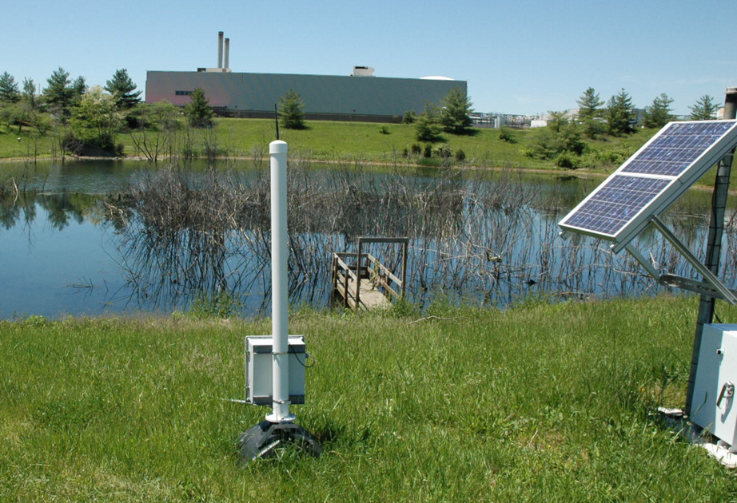
How Can We Measure Changes of a Wetland in a Classroom?
Activity:
Students create two models — one with wetland features (gravel, soil, plants) and one without. The IO Rodeo water level sensor is placed in each model’s “pond” area to measure water levels during simulated rainfall. Students compare how much water each model stores, how quickly it drains, and how well vegetation traps “pollutants” like colored water. By graphing their results, they see how wetlands reduce flooding, filter water, and support healthy ecosystems.

Slide 10
How the Sensor Helps
The IO Rodeo water level sensor helps students:
Measure how much water wetlands can hold during storms
Study how water levels rise and fall in wetland models
See how wetlands slow floodwaters and prevent erosion
Gather data to analyze wetland health and biodiversity

Slide 11
Understanding Water Conservation with a Water Level Sensor
High School Level

Slide 12
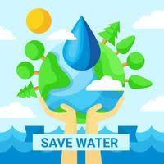
What is Water Conservation?
Water conservation is the practice of being mindful about how much water you use and trying to use less to help reduce water waste. This matters because less than 1% of Earth’s water is fresh and easily available for people to use. Conserving water also helps keep bodies of water like rivers, lakes, and wetlands healthy. Lastly, the process it takes to treat and pump water uses a lot of energy, which burns a lot of carbon emissions. So by saving and conserving water helps reduce the amount of carbon emissions which helps reduce the impacts of climate change.

Slide 13
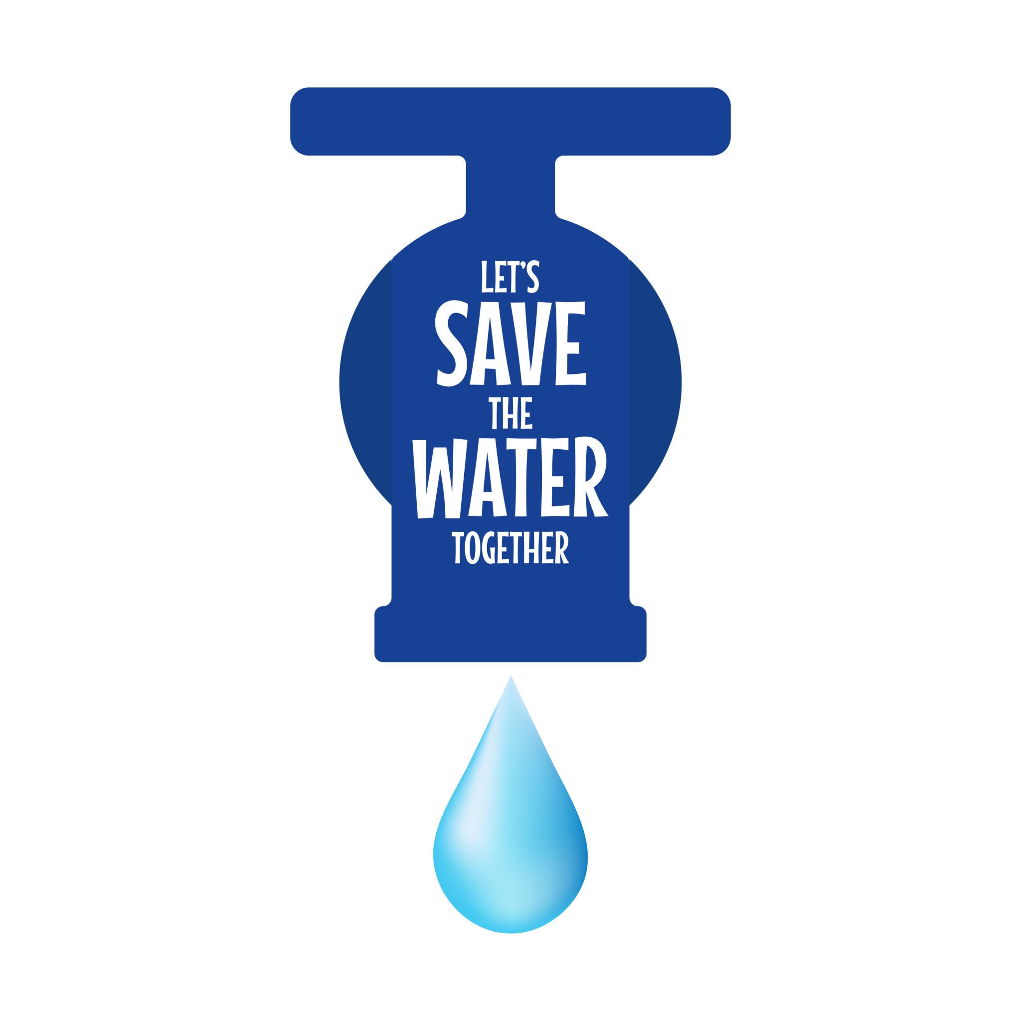
How Can We Conserve Water at Home?
Ways to conserve water at home can include:
Fixing water leaks
Collect rainwater to water gardens and plants
Take shorter showers
Don't let water run while brushing your teeth or washing the dishes

Slide 14
How Can We Measure Water Conservation in a Classroom?
Activity:
Students set up experiments comparing water loss in different conditions covered vs. uncovered containers, various soil types, and water-saving designs like mulch or drip irrigation. The water level sensor tracks water changes over time, allowing students to calculate evaporation rates, water retention, and conservation efficiency.

Slide 15
How the Sensor Helps
The IO Rodeo water level sensor helps students:
Monitor water levels to track usage and waste
Observe how much water is lost to evaporation
Study how different materials (soil, sand, mulch) affect water retention
Explore how natural systems store and conserve water

Slide 16
Understanding Watershed Modeling with a Water Level Sensor
High School Level

Slide 17
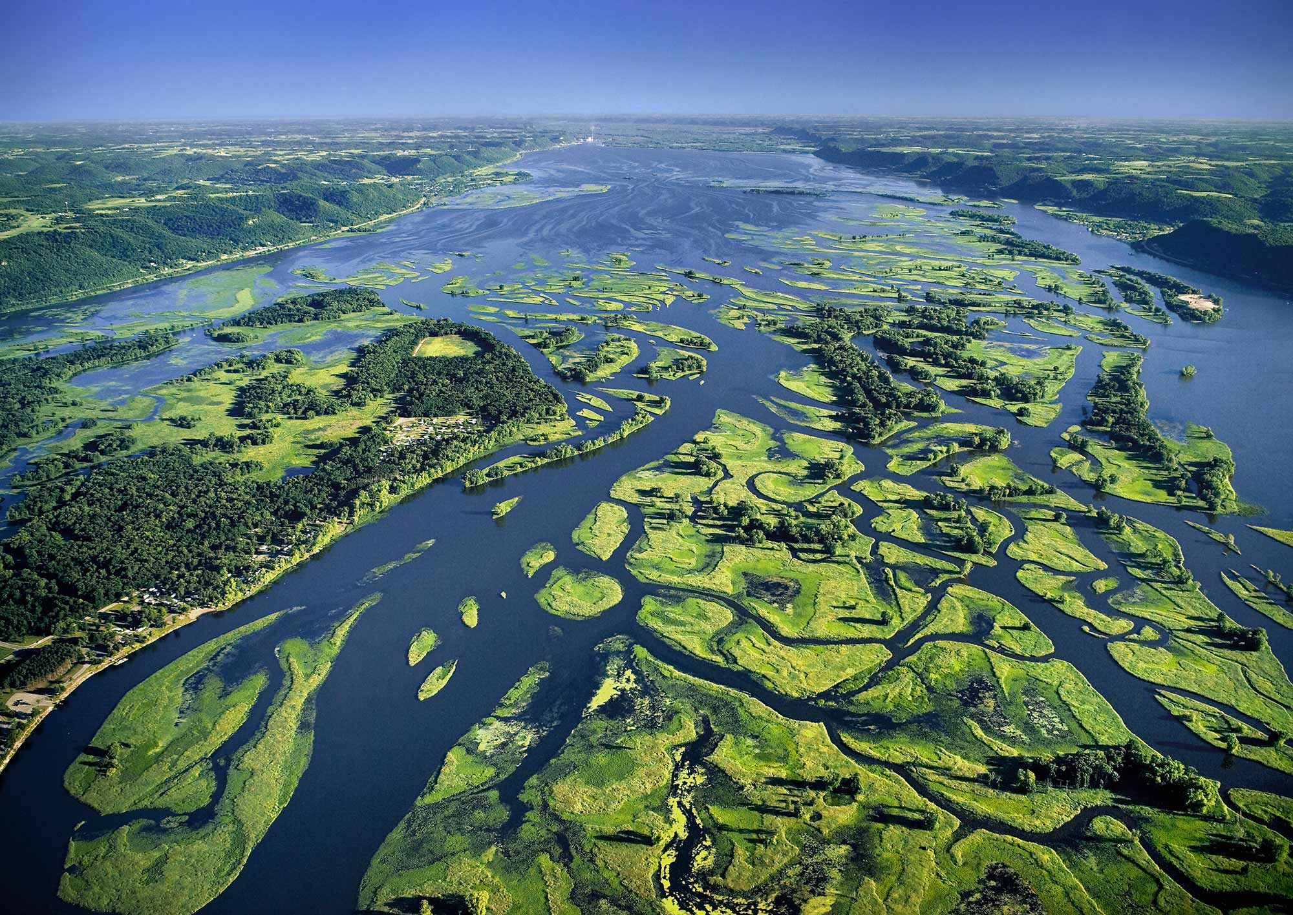
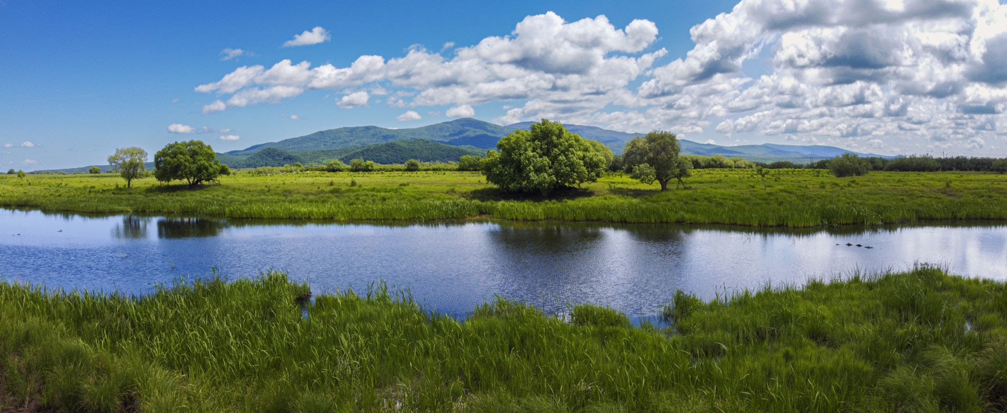
What is a Watershed?
Watersheds are an area where all forms of precipitation drain to. It is typically connected by a system of streams and channels to connect to one body of water. People rely on watersheds to provide clean drinking water.

Slide 18
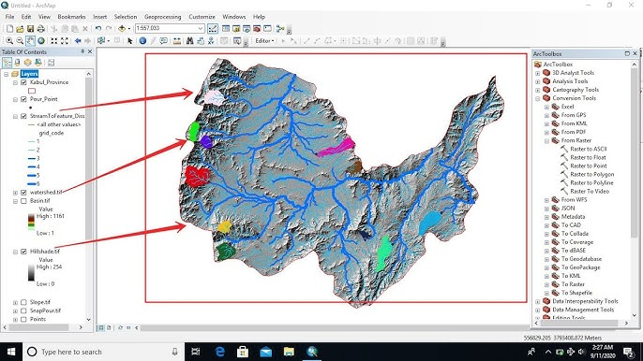
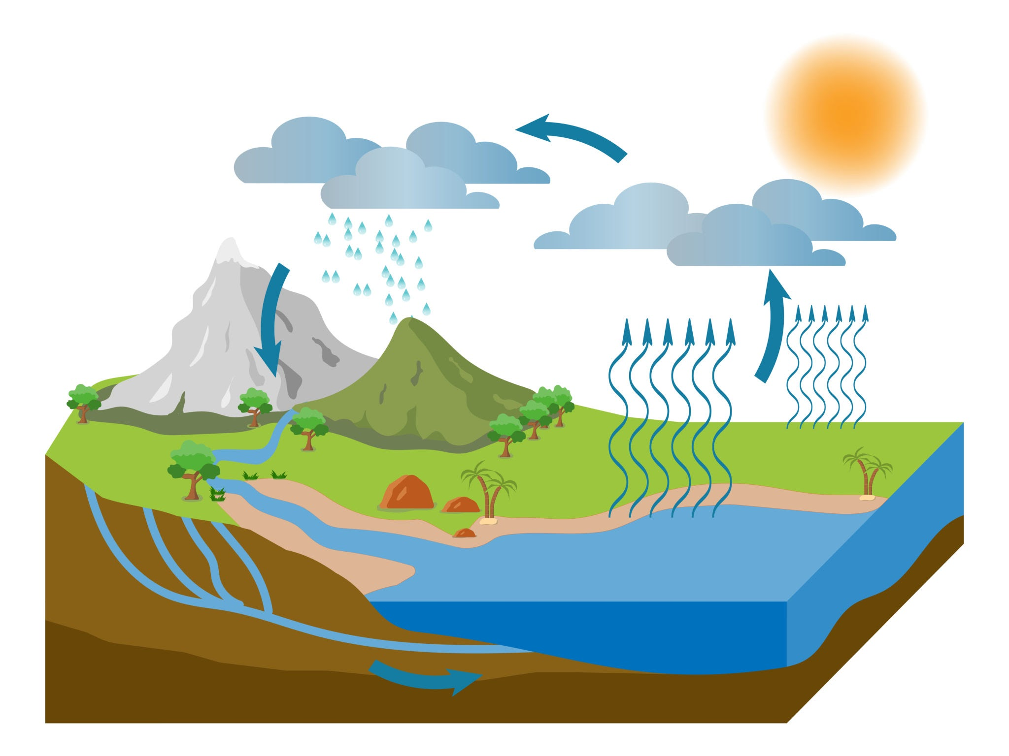
What is Hydrological Modeling?
Hydrological modeling is the process of using different types of simulations to help people understand how water moves through the environment. Things like physical models or computer programs are used to simulate these processes. Hydrological modeling helps scientist and engineers predict things like floods, droughts, and how other environmental changes affect different bodies of water.

Slide 19
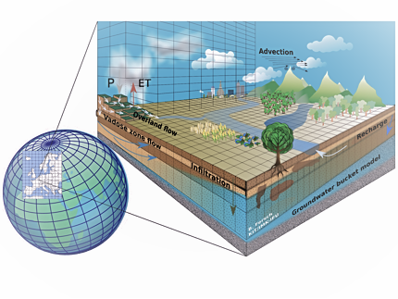
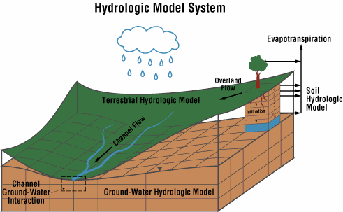
Why is Hydrological Modeling Important?
Hydrological modeling is very important because:
It can show scientist when and where a flood is likely to happen
Helps plan water storage, irrigation, and supply systems
Can predict how pollution moves through watersheds
Allows scientist to assess how changes in rainfall patterns impact water resources

Slide 20
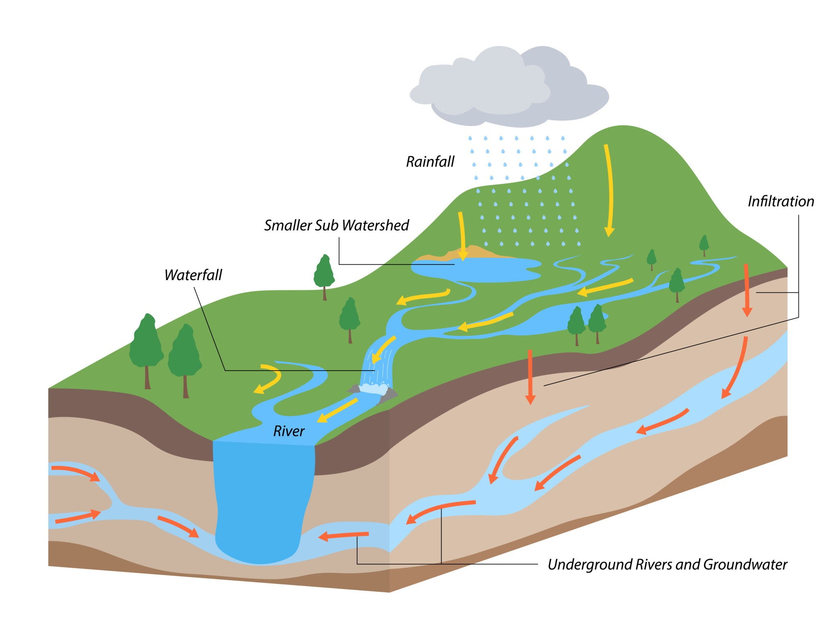
How Can We Model a Watershed in a Classroom?
Activity 1:
Students build a model watershed with hills, streams, and low basins. Using the water level sensor in the “lake” areas, they track water movement and pooling after rainfall. They compare results from models with vegetation vs. bare soil, learning how land cover impacts runoff, erosion, and storage.

Slide 21
How the Sensor Helps
The IO Rodeo water level sensor helps students:
Measure water levels in different parts of a model watershed
Track how land features (hills, pavement, vegetation) affect water flow
Collect real-time data to validate simulations or predictions
Explore how engineers plan for safe and healthy water systems

Slide 22
Understanding Flood Predictions with a Water Level Sensor
High School Level

Slide 23
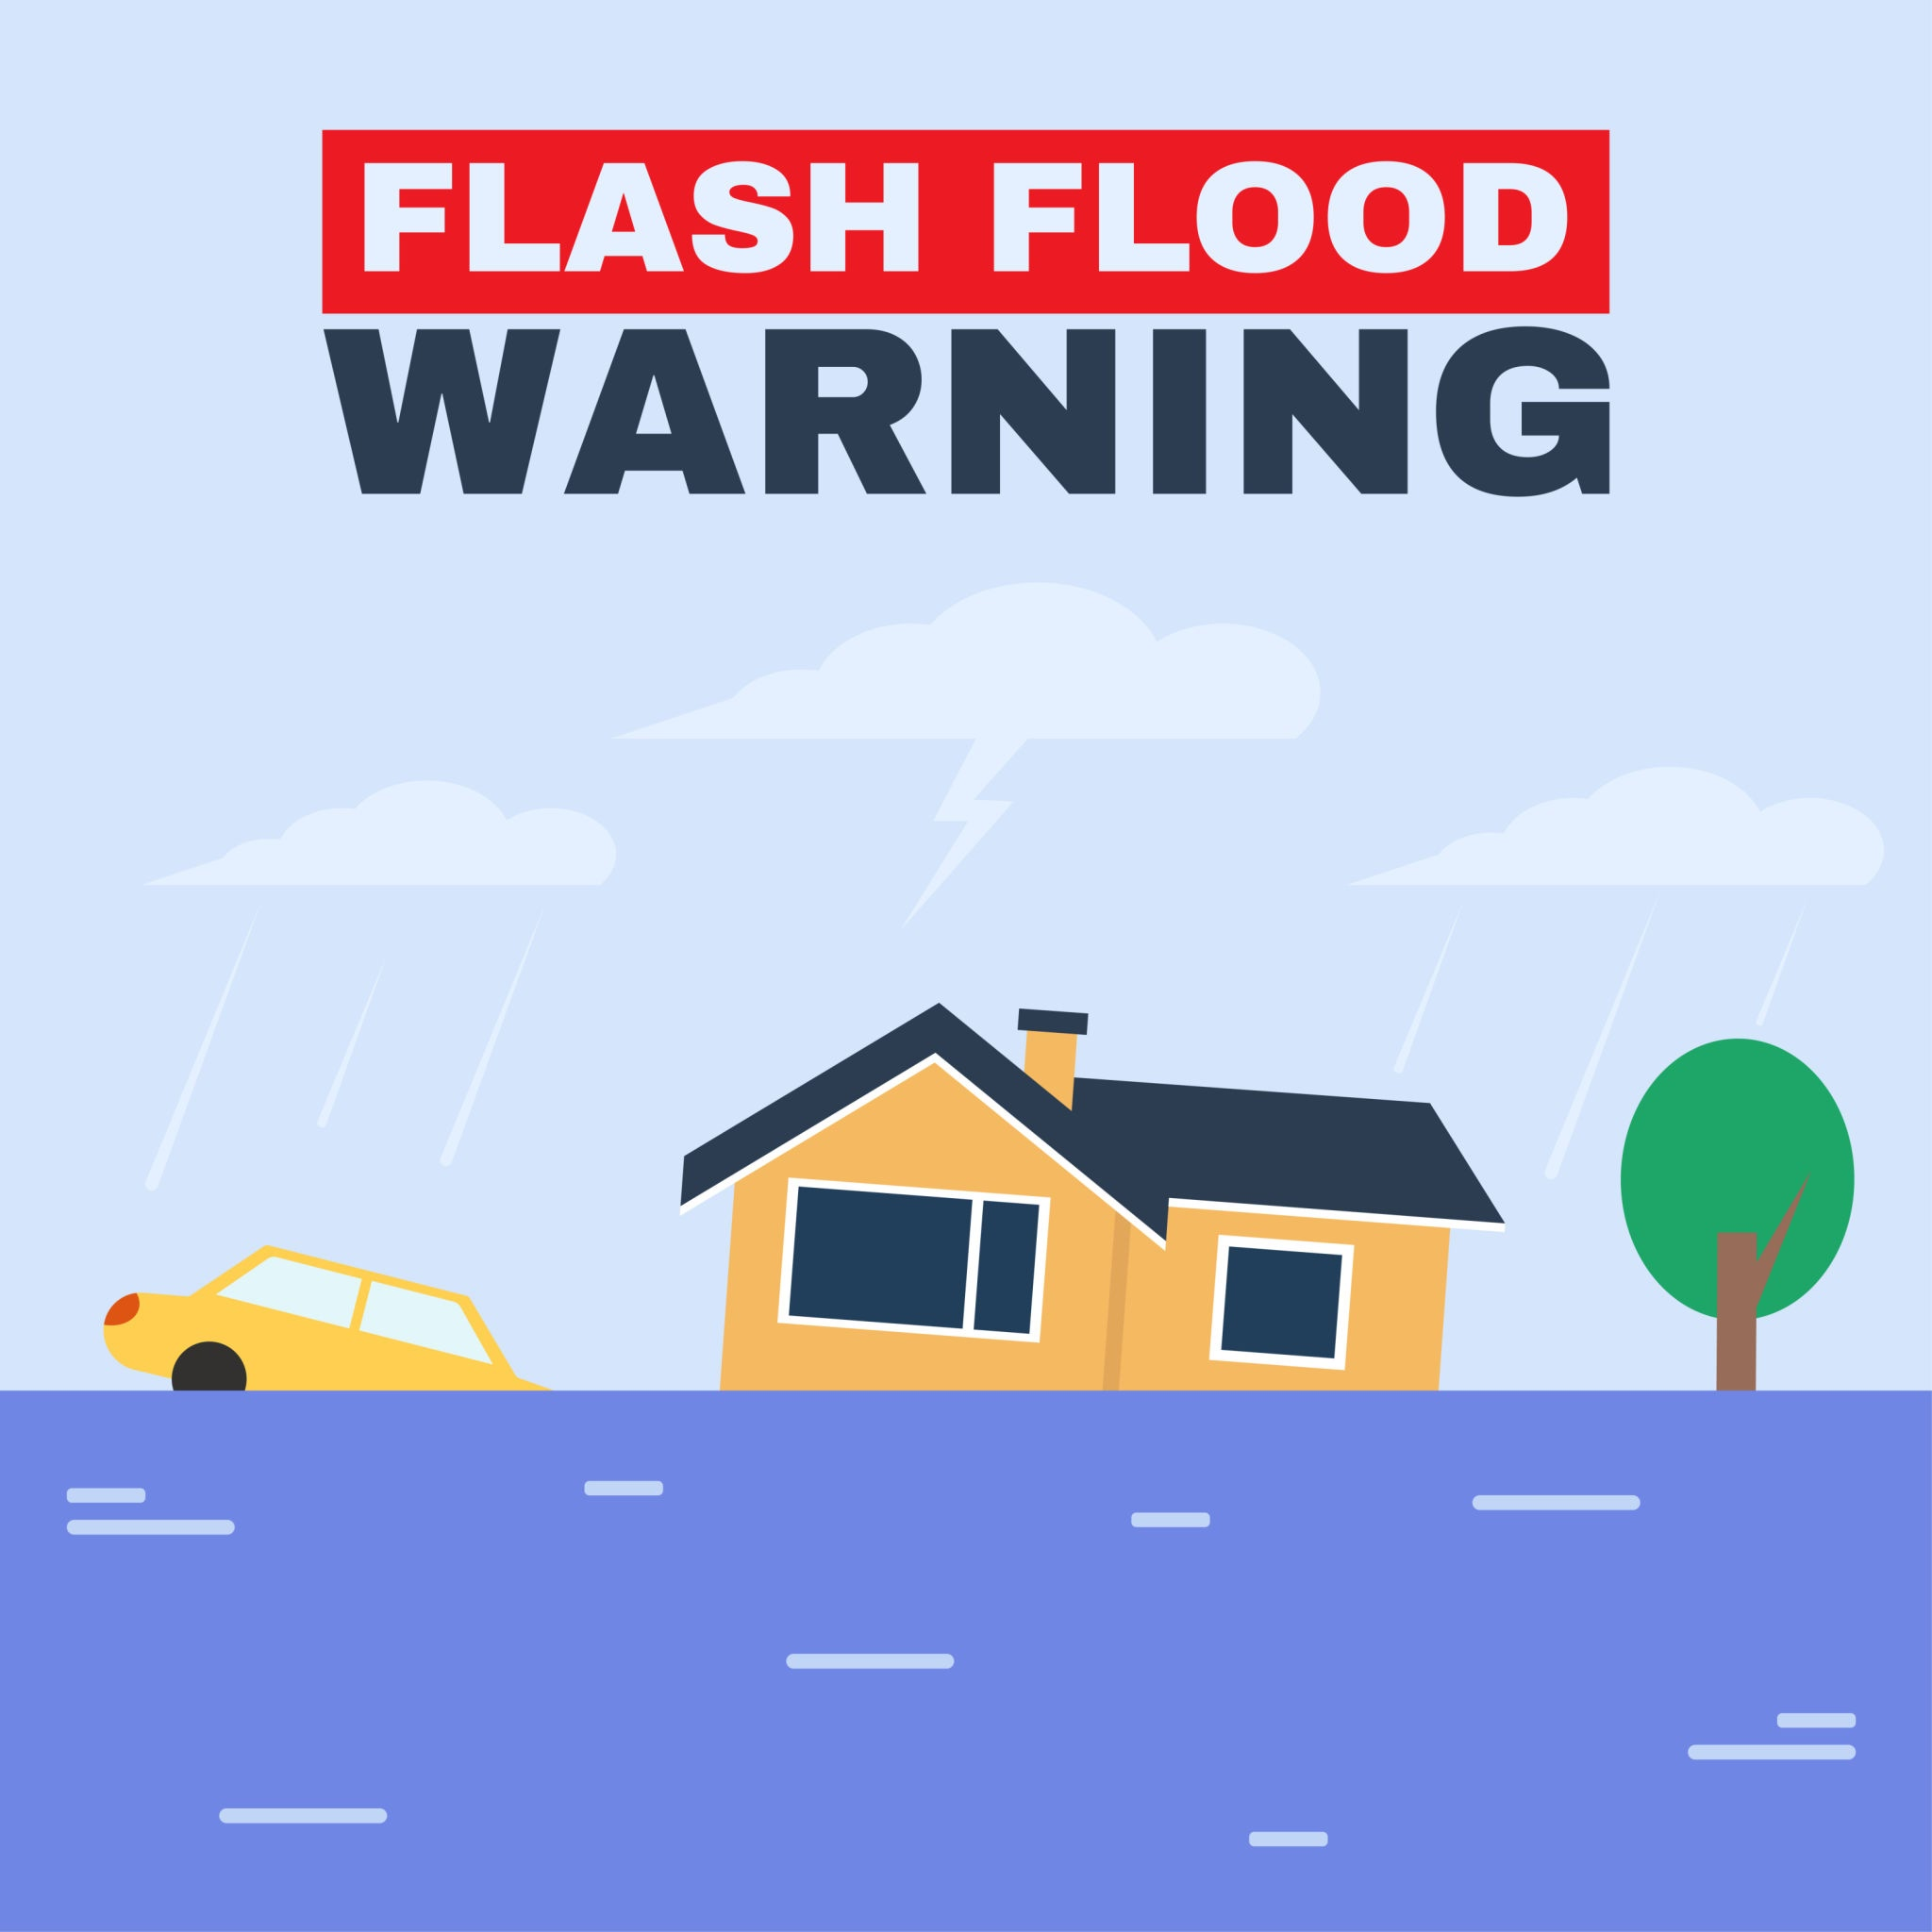
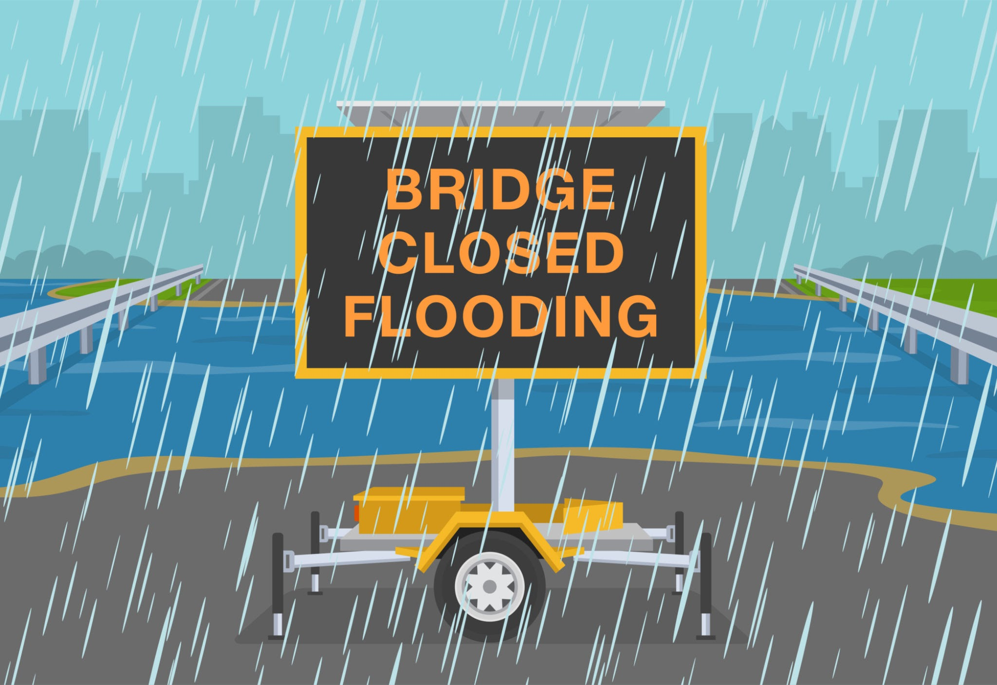
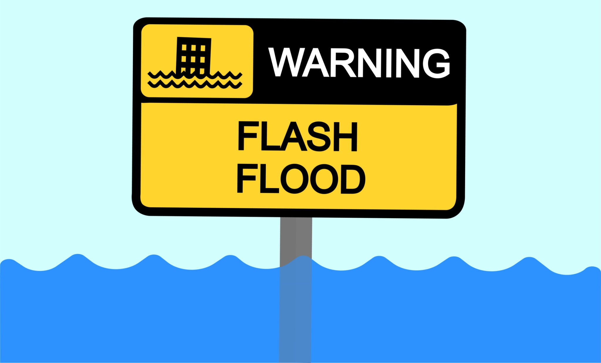
What is Flood Prediction?
Flood predictions are estimates of when and where water levels might rise too much and cause flooding. Scientist do this by looking at rainfall data, river levels, land shape, and soil type. After, they can take this data and information and transfer it into a computer models that can simulate flood like events. This helps people know when to prepare for a flood or when to evacuate well before a flood happens.

Slide 24
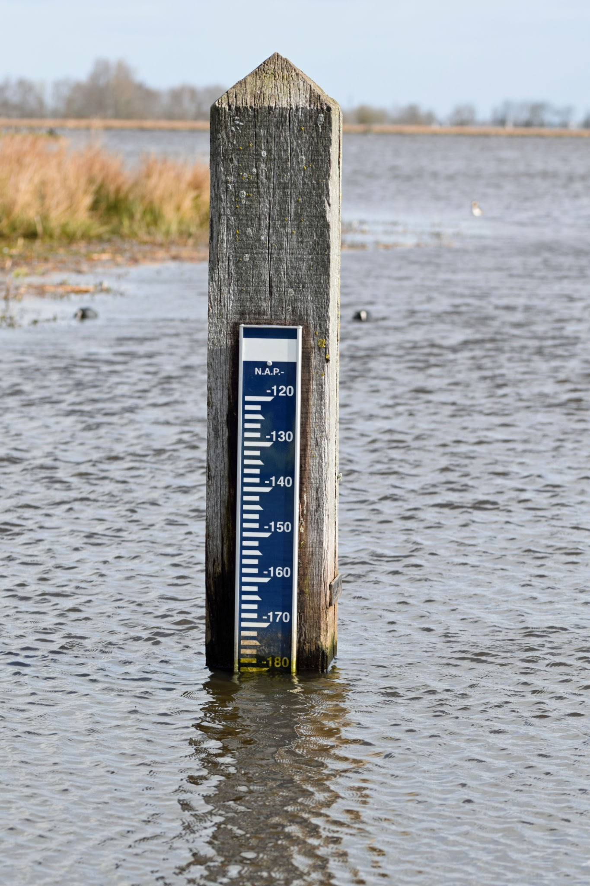
How Can We Predict Floods in a Classroom?
Activity:
Students can simulate heavy rain events in a model river or urban landscape and use the water level sensor to measure how quickly water rises. They then program a simple alert system that triggers when water reaches a set level. By combining rainfall data and water level readings, they practice predicting flood risks.

Slide 25
How the Sensor Helps
The IO Rodeo water level sensor helps students:
Monitor rising water levels during simulated storms
Create early warning systems using sensor triggers
Collect and graph water level data in real time
Build models that predict flooding based on input data

Slide 26
Understanding Urbanization Impacts with a Water Level Sensor
High School Level

Slide 27
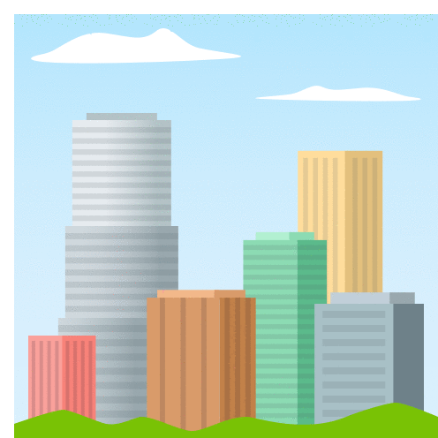
What is Urbanization?
Urbanization is when people from more rural and countryside areas move to a much more populated location such as cities or big towns. When these areas become more populated, there becomes a bigger demand for houses, roads, jobs, and food places. This means more buildings and less trees and other natural resources. This affects local ecosystems by changing how water flows and increasing the amount of pollution in an area.

Slide 28
How Can We Model the Impacts of Urbanization in a Classroom?
Activity:
Students model two areas, one paved and one vegetated, and measure water levels after identical rain events. They compare runoff speed, water storage, and drainage. The experiment shows how pavement increases flooding risk and how green infrastructure like rain gardens can improve stormwater management.

Slide 29
How the Sensor Helps
The IO Rodeo water level sensor helps students:
Compare water levels in different urban land models (pavement vs. grass)
Track runoff speed and volume during “rain” simulations
Collect data from areas around school campuses (like storm drains)
Study how green infrastructure can reduce flooding

Slide 30
Tracking Climate Change with a Water Level Sensor
High School Level

Slide 31
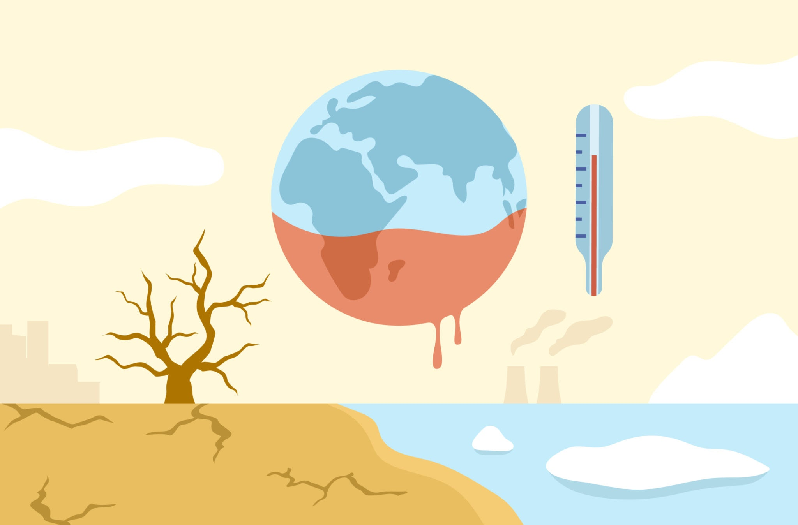
What is Climate Change?
Climate change is the long term shift in Earth’s weather patterns and temperatures. This is mainly caused by human activities such as burning fossil fuels, which release harmful greenhouse gases into the atmosphere. These pollutants get trapped in the atmosphere, which cause hotter temperatures, stronger storms, rising sea levels, and other changes in ecosystems. This affects not only the plants and animals but also us.

Slide 32
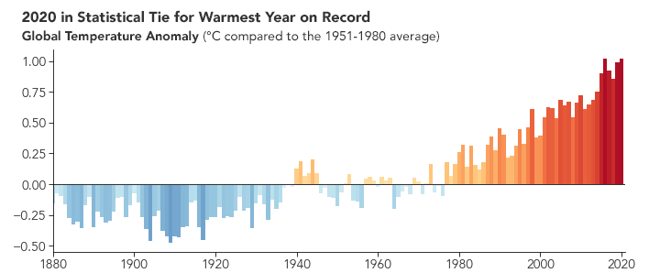
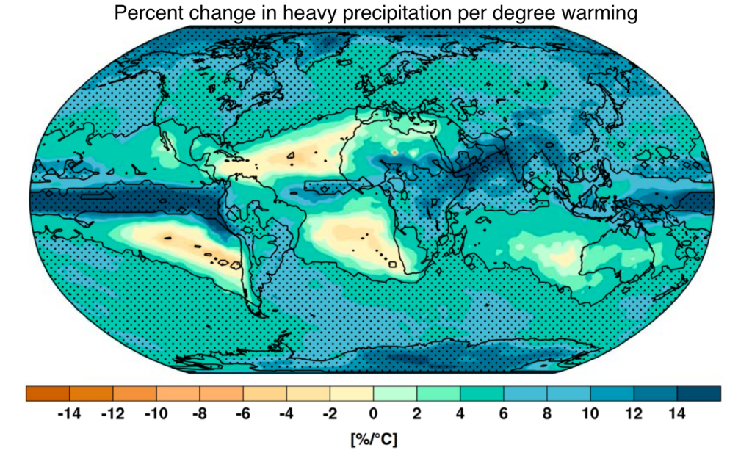
How Can We Track Climate Change Trends in a Classroom?
Activity:
Students run repeated “storm events” in a model over several weeks, tracking water level changes with the sensor. They simulate sea-level rise by slowly adding water to a coastal model. Graphing the results helps them spot trends and understand how climate change alters rainfall, flooding, and coastal flooding patterns.

Slide 33
How the Sensor Helps
The IO Rodeo water level sensor helps students:
Observe how rainfall and flooding patterns might be changing
Record long-term trends in water levels for analysis
Simulate rising seas in classroom models
Collect evidence for climate-related impacts on ecosystems

Slide 34
Understanding Community Science with a Water Level Sensor
High School Level

Slide 35
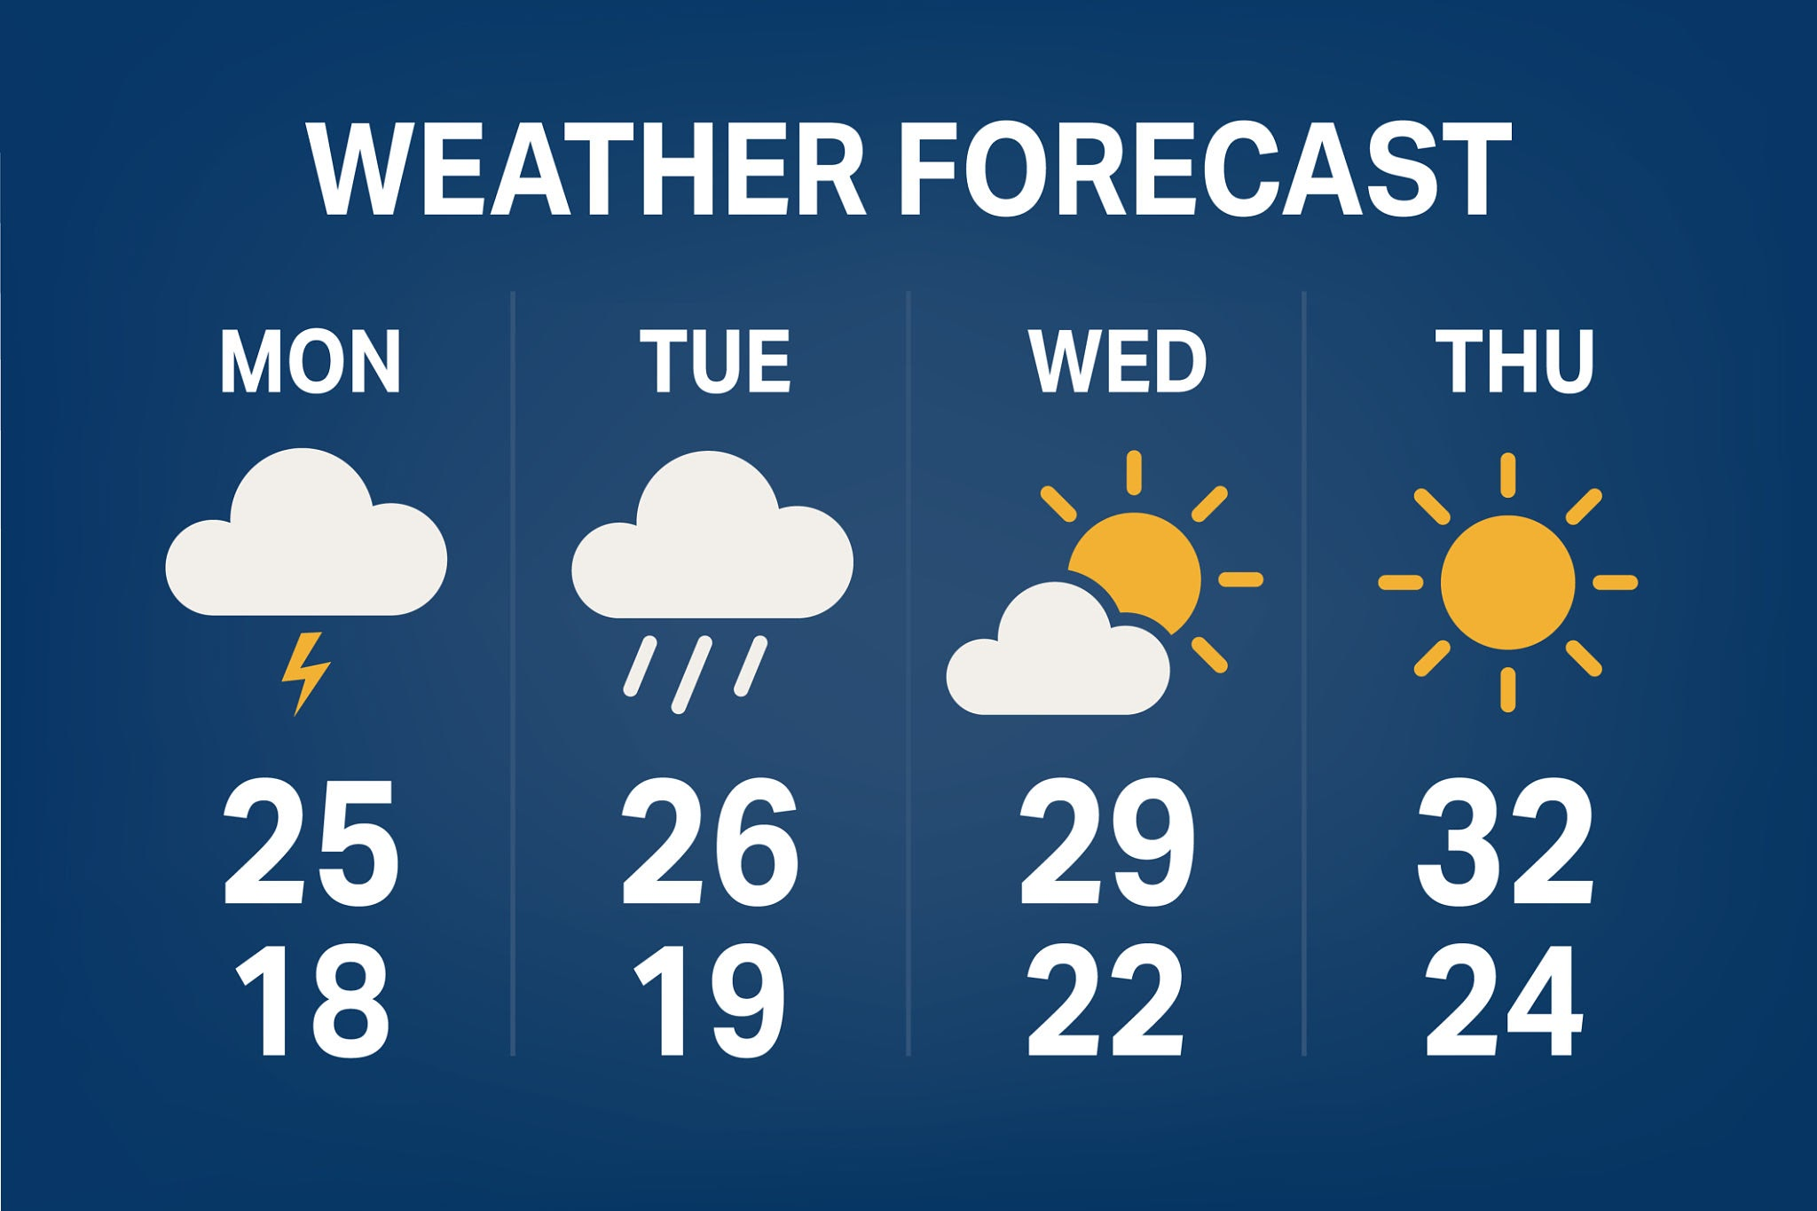
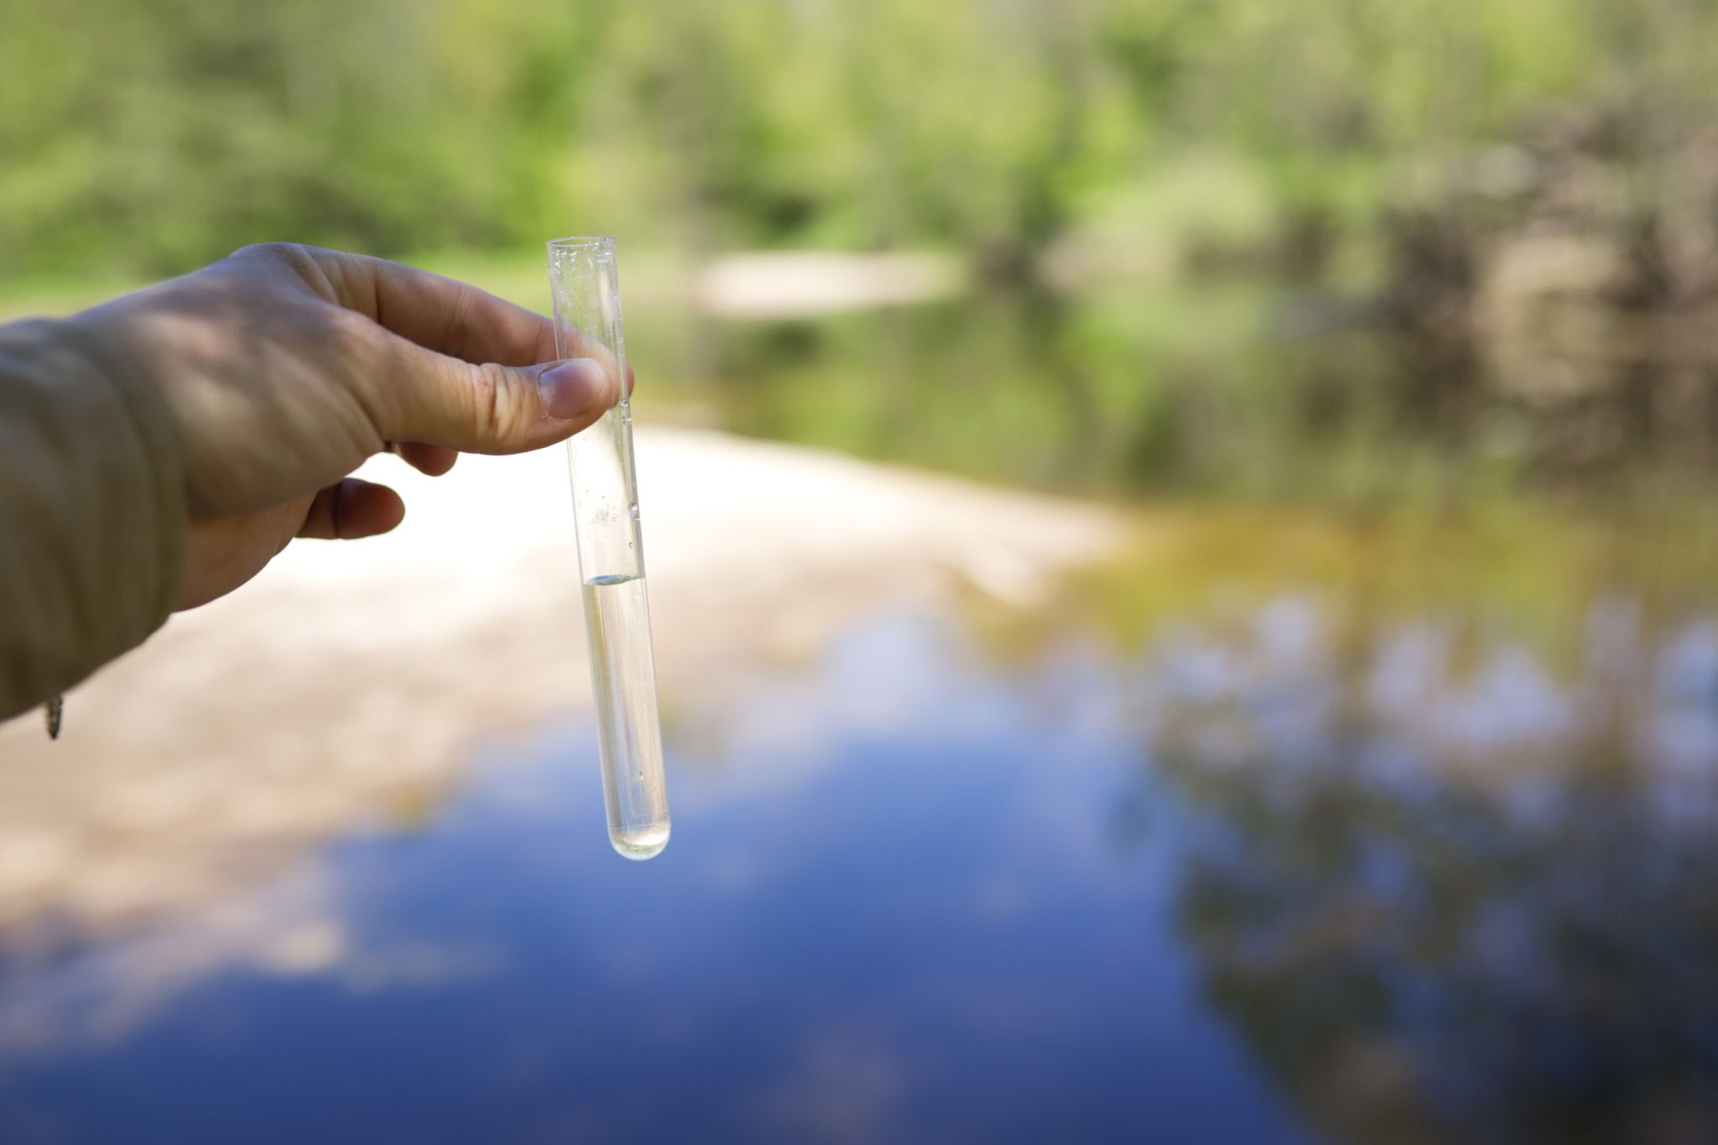
What is Community Science?
Community science refers to when regular people help scientist collect data or make observations about the environment around them. An example of this can be people reporting the local weather for the day or tracking the quality of their water at home or in local bodies of water around them. This helps scientist gather more information and data than they could gather alone. This also lets people get involved and help make a change.

Slide 36
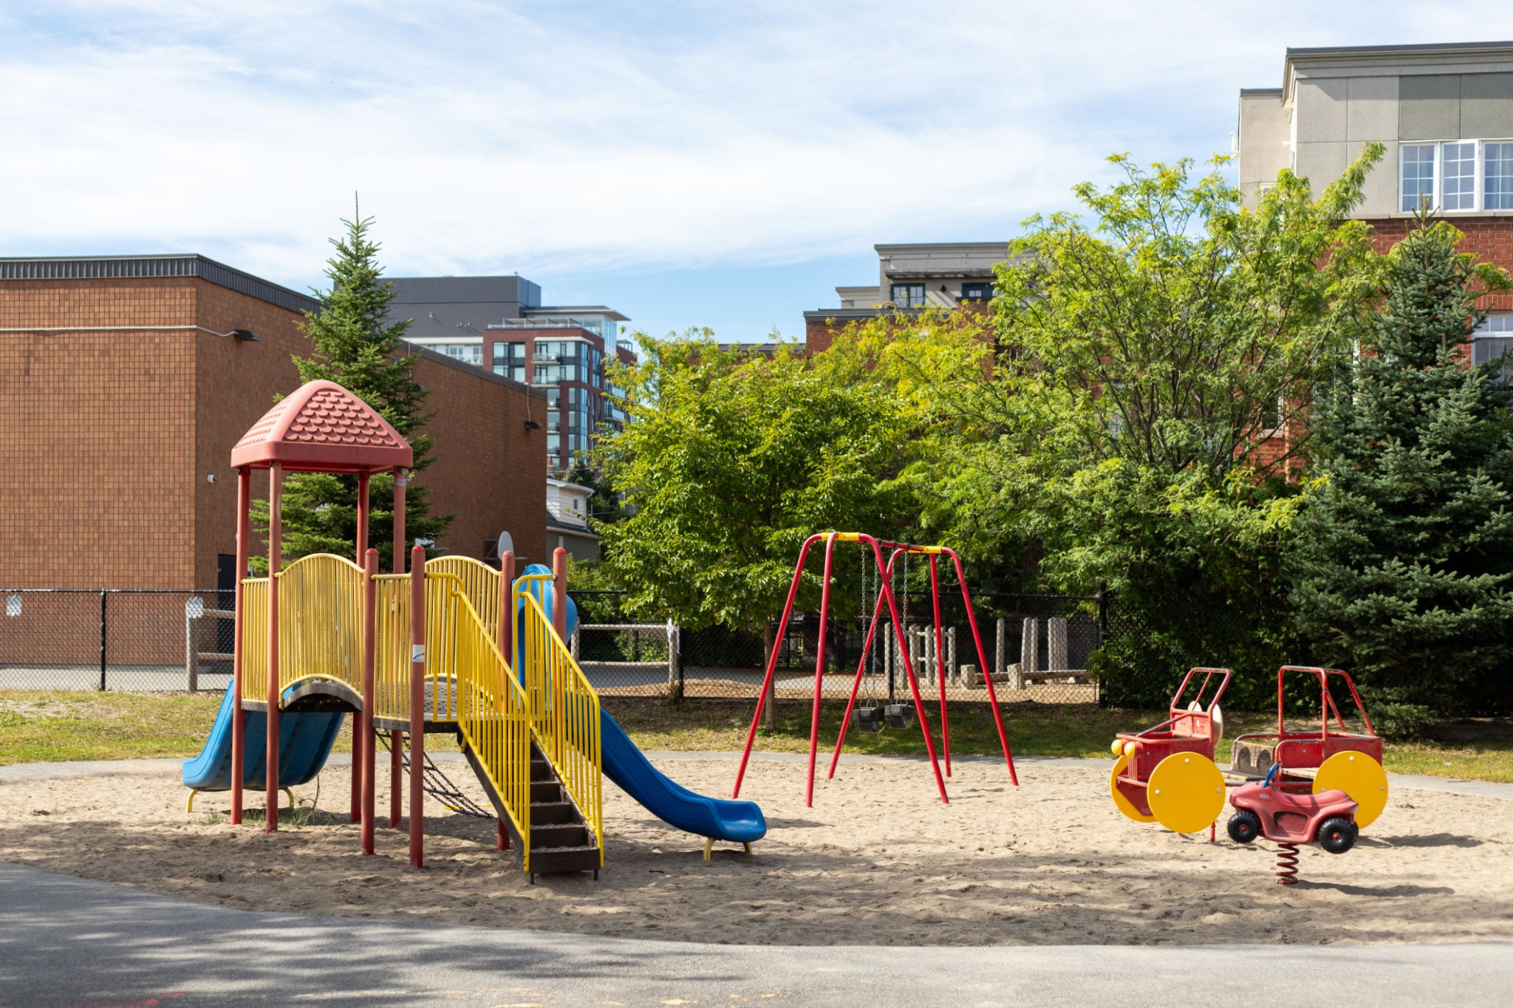
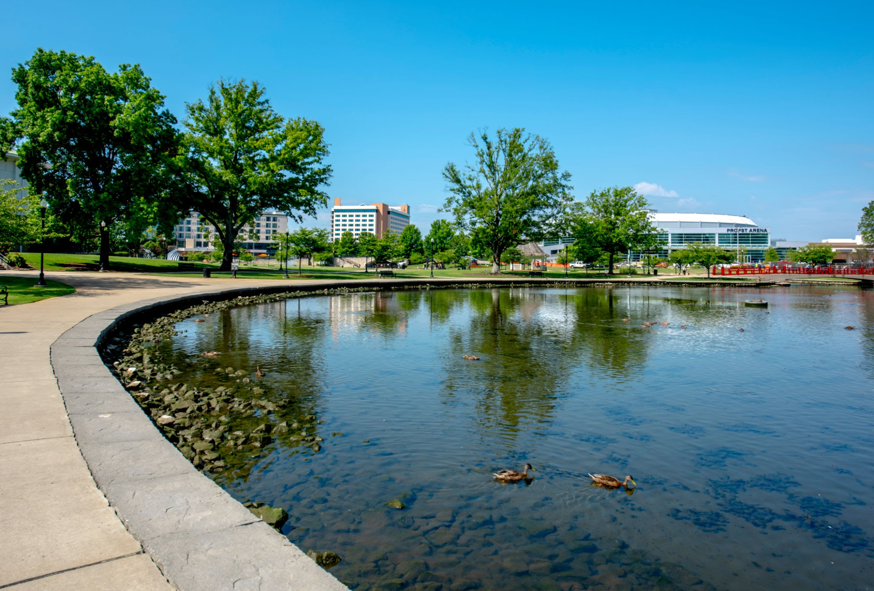
How Can We Help the Local Community in a Classroom?
Activity:
Students use the water level sensor to monitor flooding in safe, approved locations (schoolyard, park) during real rain events. They share their findings with local groups or officials and create graphs or displays to raise awareness. This turns data collection into a real community science project with civic impact.

Slide 37
How the Sensor Helps
The IO Rodeo water level sensor helps students:
Collect data from schoolyards, parks, or streams
Share results with their town, watershed groups, or community leaders
Monitor storm drains or low-lying areas during real rain events
Create reports or presentations that drive action

